Slide 1
Stroke Outcome Data
Amanda Benjamin

Slide 2
Title and Content Layout with List
Every 40 seconds, someone in the United States has a stroke and every 3.5 minutes, someone dies of stroke (1)
Many strokes could be prevented through healthy lifestyle changes (1)
(1): https://www.cdc.gov/stroke.htm

Slide 3

The Problem:
Stroke Diagnosis typically occurs after the fact
Having a tool to assess stroke likelihood could increase preventative measures and lead to less death

Slide 4
Stroke Prediction Dataset
Feature | Patient 1 | Patient 5110
ID | 1 | 5110
Gender | Male | Female
Age | 67 | 37
Hypertension | 0 | 0
Heart Disease | 1 | 0
Marital Status | Yes | No
Work | Private | Private
Residence | Urban | Rural
Ave. Glucose | 228.69 | 91.72
BMI | 36.6 | 29.2
Smoking Status | Former | Never
Stroke | 1 | 0
Found at: https://www.kaggle.com/datasets/fedesoriano/stroke-prediction-dataset
Provides 11 clinical features for 5110 patients

Slide 5
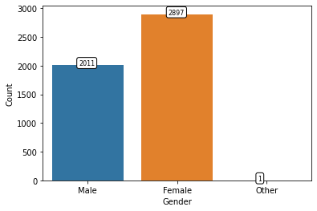
Visualization #1

Slide 6
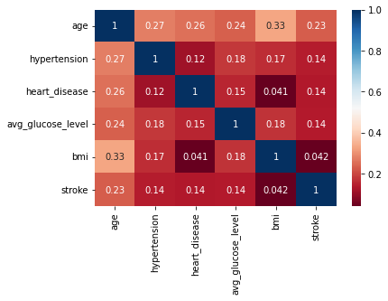
Visualization #2

Slide 7

The Solution:
Utilized a Logistic Regression Model that models the probability of an outcome (stroke) given inputs (clinical data)
Tested correctly 96% of the time
Unbalanced Data

Slide 8
Conclusion
Population representation in data is critical
Age is the ‘strongest’ indicator for the likelihood of stroke

